Slide 1
Module CS5052NI Professional Issues, Ethics and Computer Law
2023

Slide 2
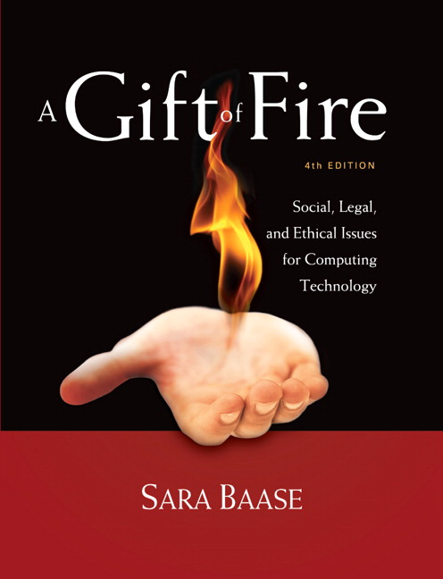
A Gift of Fire Fifth edition Sara Baase
Chapter 1.4: Ethics

Slide 3

Agenda
Ethics
Morals
Ethical Values and Types
Personal preference and Ethics
Laws Vs Ethics

Slide 4
New Technology – and Ethics
Should you download Movies / Music from Unauthorized Websites?
Is taking on the Mobile Phone while Driving on Highway ok?
Should you hire Foreign Programmers who work at Low Salaries?
Should you fire Employee who criticizes your business in Social Media?
Should you attempt to prosecute employee who whistle-blows by releasing data to press?
Notes:
In these examples, you are confronting practical and legal issues—and ethical ones. In each case you can restate the problem as a question in the form “Is it right to . . . ?” Is it right to make a significant change in your company’s privacy policy without giving customers or members advance notice?
In this Lecture, we introduce several ethical theories. We discuss some distinctions (e.g., between ethics and law) that are important to understand when tackling ethical issues.

Slide 5
Ethics
Study of what it means to “do the right thing”.
Impact on how individuals make choices and live their life.
Assumes people are rational and make free choices.
Rules to follow in our interactions and our actions that affect others.
Notes:
Ethics is the study of what it means to “do the right thing.” It is a complex subject that has occupied philosophers for thousands of years.
Ethical theory assumes that people are rational and make free choices. Neither of these conditions is always and absolutely true. People act emotionally, and they make mistakes. A person is not making a free choice when someone else is pointing a gun at him. Some argue that a person is not making a free choice in a situation where she might lose a job. However, free choice and use of rational judgment are capacities and characteristics of human beings, and they are reasonably assumed as the basis of ethical theory. We take the view that the individual is, in most circumstances, responsible for his or her actions.

Slide 6


What makes a person good?
Be good, help others in need and live a virtuous life.
Is it following rules, listening to elders, or doing what you are told?

Slide 7

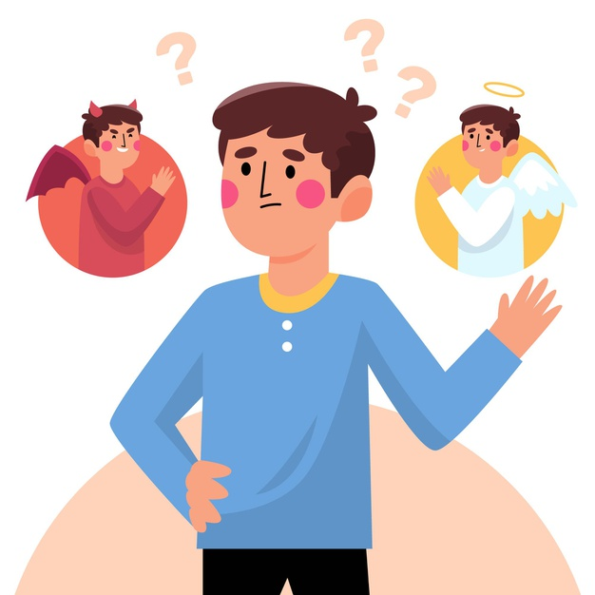
Ethics
The Greek word ‘ethos’ means customs, behaviours or habits.
The study of what it means to do the right thing.
A branch of philosophy that deals with having right behaviour and leading a good life.
Notes:
https://www.freepik.com/free-vector/ethical-dilemma-illustration_10878743.htm#page=1&query=good%20person&position=10
https://www.freepik.com/free-vector/woman-expressing-strong-various-feelings-emotions_8271103.htm#query=behaviors&position=3

Slide 8

Morals
Ethics: the theory of doing what is right for greater good.
Morals emphasise the practice of actually doing something to achieve that greater good.
Both are equally important and set guidelines for acceptable behaviour in our society.
Notes:
https://www.freepik.com/free-vector/reading-list-concept-illustration_7769807.htm

Slide 9

Origins of ethics
Every society has some form of myth explaining its origin.
Reflection of our behaviour and suggestions on the best way to live.
Notes:
https://www.freepik.com/free-vector/religion-confession-illustration_4431175.htm#page=1&query=religion&position=4
https://www.freepik.com/free-vector/religions-icon-set_6086660.htm#page=1&query=religion&position=20

Slide 10
Example
Buddhism refrains its followers from taking the life, abstain from stealing, acting unjustly, telling lies, and drinking intoxicant substances.
Bhagwat Geeta, provides a guide to self-realisation .
Quran says that if we do not follow the rules and live an ideal life, there will be a day of judgment in our afterlife.
Notes:
https://www.freepik.com/free-vector/religions-icon-set_6086660.htm#page=1&query=religion&position=20

Slide 11
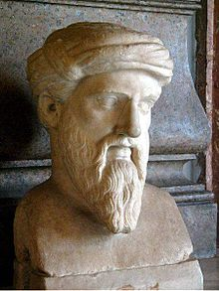
Pythagoras of Samos
Mathematician and a Philosopher known for Pythagorean Theorem.
Formed a brotherhood that was devoted to moral, political and social life.
This society was known as Pythagoreans.
Influenced philosophies of Plato, Aristotle, and, through them, Western philosophy.

Slide 12
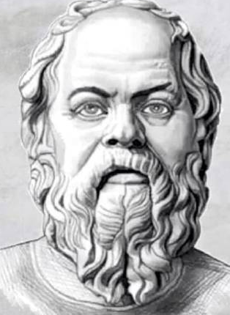
Socrates
Born – 469 BC – Athens – Greece
Credited as one of the founders of Western philosophy.
Interested in the thinking process.
It clarified the concepts of Good and Justice.
If you have any problem, break it down to a series of questions and you find your required answer in those responses.
Process of questioning is called the “Socratic Method”.

Slide 13
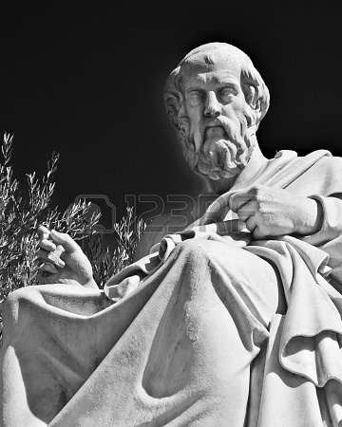
Plato
Born – Circa 428/9 BC – Athens -Greece
Socrates’ student
Recorded the speeches made by Socrates
Known for founding Academy north of Athens, traditionally considered the first university in western world.
Plato wrote his ideas about an “ideal state” in a book called The Republic.

Slide 14
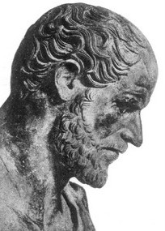
Aristotle
Born (384 B.C. to 322 B.C.) philosopher and scientist
Founder of the Lyceum and the Peripatetic school of philosophy and Aristotelian tradition.
Along with his teacher Plato, has been called the "Father of Western Philosophy”
Began tutoring Alexander the Great.
Examined human behavior in the context of society and government.

Slide 15
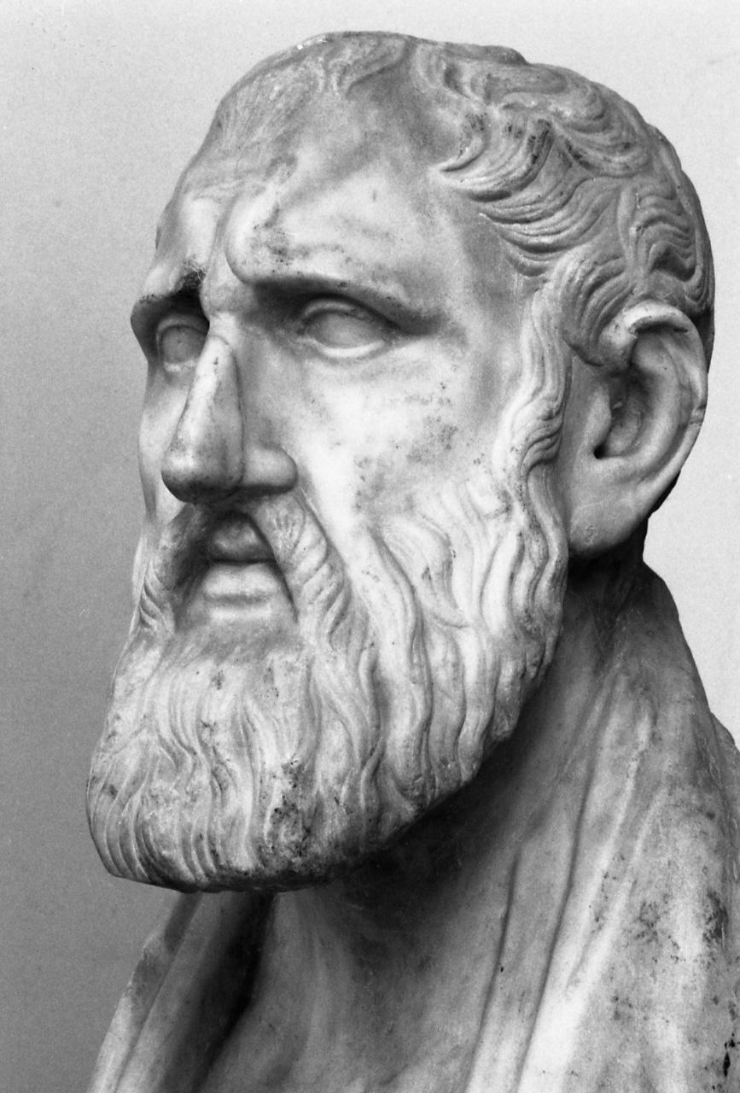
Zeno of Citium: Stoicism
Born (334BC – 262 BC)
Founder of the Stoic school of philosophy, in Athens from about 300 BC.
Teaches self-control and resilience as a means of overcoming destructive emotions.
Stoicism: pursuing self-improvement through four cardinal virtues , (derived from the teachings of Plato): wisdom ("sophia"), courage ("andreia"), justice ("dikaiosyne") and temperance ("sophrosyne").
Notes:
Rather than imagining an ideal society, the Stoic tries to deal with the world as it is while pursuing self-improvement through four cardinal virtues , (derived from the teachings of Plato): wisdom ("sophia"), courage ("andreia"), justice ("dikaiosyne") and temperance ("sophrosyne").
Philosophy : Everything around us operates according to cause and effect, we may not always have control over the events affecting us, we can have control over how we approach things.
Similar to Buddhism, which has four noble truths: all life has suffering; suffering is rooted in passion and desire; happiness is freedom from the passions; moral restraint and self-discipline is the means by which one becomes free from sufferings.

Slide 16
What are Ethical Rules?
Rules to follow during the interactions between people and actions that affect other people.
Goal of ethical theories: to enhance human dignity, peace, happiness and well being.
Apply to all of us.
Intended to achieve good results for people in general and for situations in general – not just for ourselves, not just for one situation
Notes:
Ethical rules are rules to follow in our interactions with other people and in our actions that affect other people. Most ethical theories attempt to achieve the same goal: to enhance human dignity, peace, happiness, and well-being. Ethical rules apply to all of us and are intended to achieve good results for people in general, and for situations in general—not just for ourselves, not just for one situation. A set of rules that does this well respects the fact that we are each unique and have our own values and goals, that we have judgment and will, and that we act according to our judgment to achieve our goals. The rules should clarify our obligations and responsibilities—and our areas of choice and personal preference.

Slide 17
Ethics - differing viewpoints
Fundamental and universal, like the laws of science
Or
Rules of games that provide framework on how to interact with people in a peaceful, productive way.
The main aim of any ethical theory is to do what is right and good since it involves moral rules or acting based on specific ethical values
Notes:
No need to decide which view is correct. In either case include reason, introspection, and knowledge of human nature, values, and behavior.
We could view ethical rules as fundamental and universal, like laws of science. Or we could view them as rules we make up, like the rules of baseball, to provide a framework in which to interact with other people in a peaceful, productive way. The titles of two books illustrate these different viewpoints. One is Ethics: Discovering Right and Wrong; the other is Ethics: Inventing Right and Wrong.18 We do not have to decide which view is correct to find good ethical rules. In either case, our tools include reason, introspection, and knowledge of human nature, values, and behavior.

Slide 18
Ethicists distinctions
Ethical theories that view certain acts as good or bad because of some basic aspect of the action – deontological "obligation, duty” (or non consequentialist) theories
And
Ethical theories that view acts as good or bad because of their consequences or results – consequentialist theories (judgment about the rightness or wrongness)
Notes:
There are many different theories about how to establish a firm justification for the rules and how to decide what is ethical in specific cases. Some ethicists make a distinction between ethical theories that view certain acts as good or bad because of some intrinsic aspect of the action and ethical theories that view acts as good or bad because of their consequences. They call these deontological (or nonconsequentialist) and consequentialist theories, respectively. The distinction is perhaps emphasized more than necessary. If the criteria that deontologists use to determine the intrinsic goodness or badness of an act do not consider its consequences for people—at least for most people, most of the time—their criteria would seem to have little ethical merit.

Slide 19
Ethical Principles
Virtue Theory
Deontological Ethics
Utilitarianism
Rights

Slide 20
Virtue Theory
Emphasizes on merits or moral character; rather than one’s duties or rules or consequences of actions .
A virtue ethicist is likely to give you this kind of moral advice: “Act as a virtuous person would act in your situation.”
Began with Socrates, was subsequently developed further by Plato, Aristotle, and Zeno.
Take inspiration from Aristotle who declared that “a virtuous person is someone who has ideal character traits”.

Slide 21
Virtue Theory
Aristotle: a person can improve his or her character by practicing self-discipline, while a good character can be corrupted by repeated self-indulgence.
He said that having virtue just means doing the right thing, at the right time, in the right way, in the right amount, toward the right people.
Zeno: Everything around us operates according to cause and effect, we may not always have control over the events affecting us, we can have control over how we approach things.

Slide 22

Example
Walking home from a movie, you see a person being mugged. What action will you take?
Your impulse might be to say that a courageous person would run over there and stop the mugging, because courage means putting yourself in harm's way for a good cause, right?

Slide 23
Example
A virtuous person – in the Aristotelian sense would first understand the situation.
If you size up the mugger and have a good reason to believe that he could safely intervened, then that's probably the courageous choice.
But if you recognize that intervention is likely to mean that both you and the victim will be in danger, the courageous choice is not to intervene, but to call for help instead.

Slide 24
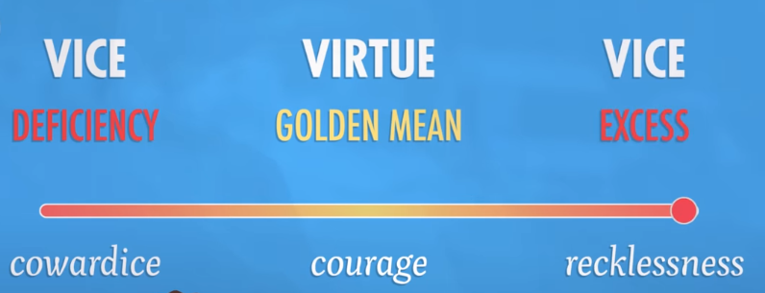
Aristotelian sense
Aristotle : “You can have too much of a good thing. So, being courageous doesn’t mean rushing headlong into danger”.
A courageous person will assess the situation, they’ll know their own abilities, and they’ll take action that is right in the situation

Slide 25
Example
A virtuous person – in the Stoicism believes every situation can be reacted to in one of two ways. You can choose to become overwhelmed and abandon or help the person.
In either way, you remind yourself, that you did things that you possibly regret, but you also learned from it. So you try to improve in the future. This is very important.
"The best revenge is to be better than the person who caused the injury”- Stoicism

Slide 26
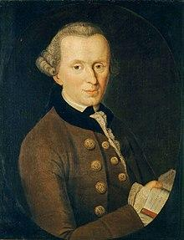
Deontological theories
Deontology is an ethical theory that uses rules to distinguish right from wrong.
A person will follow his or her obligations to another or society as upholding one’s duty is what is considered ethically correct.
For instance, a deontologist will always keep his promises to a friend and will follow the law.
Non consequentialist
Immanuel Kant (1724 –1804 Germany)

Slide 27
Deontological theories
Principle of Universality – We should follow rules of behavior that we universally apply to everyone.
Rationality is the standard for what is good - deontologists argue that logic or reason determines rules of ethical behavior, that actions are intrinsically good because they follow from logic.
Principle about Interacting with People - One must never treat people as merely means to an end but rather as ends in themselves

Slide 28

Deontological theories
Kant took an extreme position on the absolutism of ethical rules. He argued it is always wrong to lie.
Example: If a person is looking for someone he or she intends to murder, and he asks you where the intended victim is. Is it wrong to lie to protect the victim?
Kant: Ethical actions follow universal moral laws, “Don’t lie. Don’t steal. Don’t cheat.” It doesn’t require weighing the costs and benefits of a situation.
Notes:
Most people would agree there are cases in which even very good, universal rules should be broken because of consequences.
Deontology doesn’t require weighing the costs and benefits of a situation.
This avoids subjectivity and uncertainty because you only must follow set rules.

Slide 29
Example:
Suppose you’re a software engineer and learn that a nuclear missile is about to launch that might start a war. What will you do?
You can hack the network and cancel the launch, but it’s against professional code of ethics to break into any software system without permission. And, it’s a form of lying and cheating.
Deontology advises not to violate these rules.
However, in letting the missile launch, thousands of people will die.
Following the rules makes deontology easy to apply. But it also disregards the possible consequences of our actions.

Slide 30
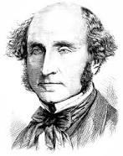
Utilitarianism
Based on one’s ability to predict the consequences of an action.
To a utilitarian, the choice that yields the greatest benefit to the most people is the one that is ethically correct.
John Stuart Mill (May 20, 1806, -May 8, 1873), English philosopher, economist, and exponent of Utilitarianism

Slide 31
Consequentialist theory: John Stewart Mill guiding principles:
Key purpose is to increase happiness or utility
A person’s utility is what satisfies a person’s needs and values
An action may decrease utility for some people and increase it for others.
Two types of utilitarianism, act utilitarianism and rule utilitarianism
Pleasure or Happiness Is the Only Thing That Truly Has Intrinsic (Core) Value.

Slide 32
Utilitarianism: Valuable theory
Valuable theory: Only thing that's valuable is happiness and the absence of suffering. Everyone's Happiness Counts Equally.
Actions Are Right Insofar (to the extent that ) as They Promote Happiness, Wrong Insofar as They Produce Unhappiness.
The theory of right action: The right action is the one that maximizes and produces the most expected value.
If you put these two pieces together, you get utilitarianism

Slide 33
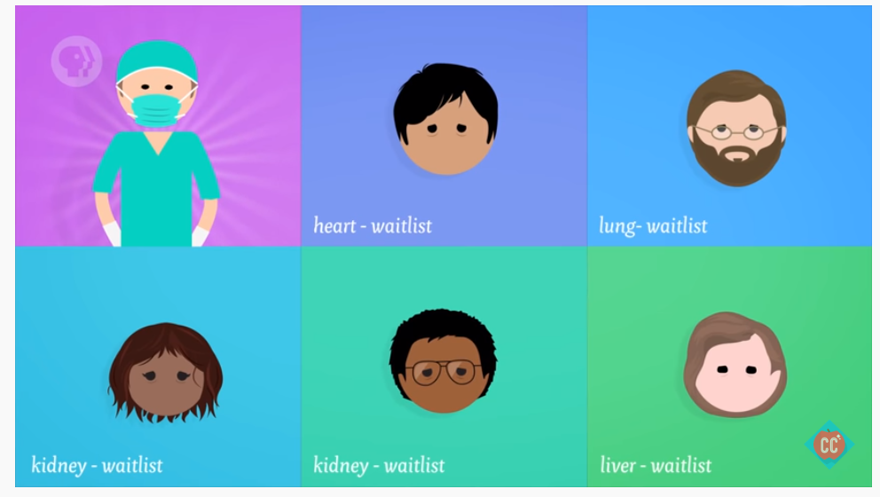

Example
Notes:
For instance, suppose a surgeon has five patients, all waiting for transplants. One needs a heart, another a lung. Two are waiting for kidneys and the last needs a liver. The doctor is pretty sure that these patients will all die before their names come up on the transplant list. And he just so happens to have a neighbor who has no family.
Total recluse. Not even a very nice guy.
The doctor knows that no one would miss this guy if he were to disappear. And by some miracle, the neighbor is a match for all five of the transplant patients. So, it seems like, even though this would be a bad day for the neighbor, an act-utilitarian should kill the neighbor and give his organs to the five patients.
It’s the greatest good for the greatest number.
Yes, one innocent person dies, but five innocent people are saved.
This might seem harsh, but remember that pain is pain, regardless of who’s experiencing it.
So the death of the neighbor would be no worse than the death of any of those patients dying on the transplant list
In fact, it’s five times less bad than all five of their deaths.

Slide 34
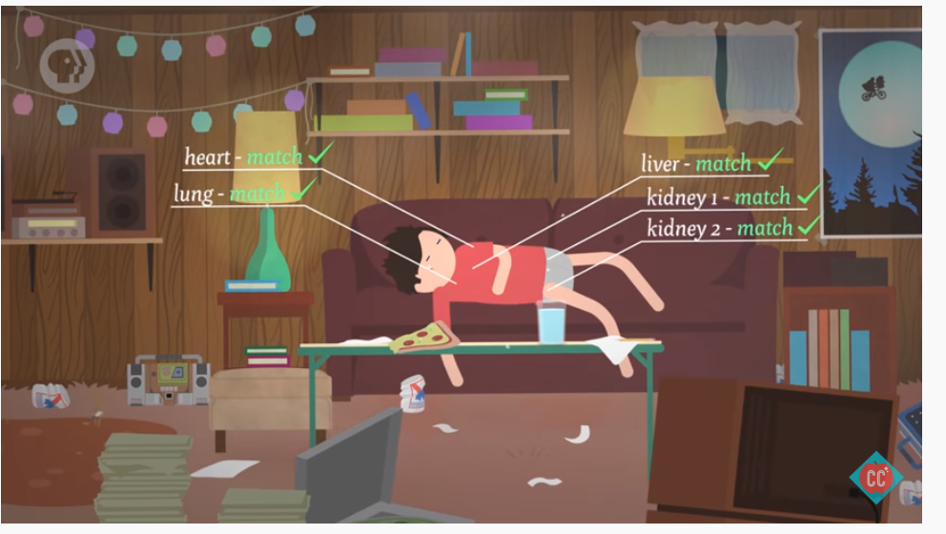
Example
“We should act always so as to produce the greatest good for the greatest number.”- principle of utility.
Why? Because saving the five lives provides more happiness than saving just one life.
It's important to notice that we accept the utilitarian claim that the right action is the one that makes the most value.
Notes:
For instance, suppose a surgeon has five patients, all waiting for transplants. One needs a heart, another a lung. Two are waiting for kidneys and the last needs a liver. The doctor is pretty sure that these patients will all die before their names come up on the transplant list. And he just so happens to have a neighbor who has no family.
Total recluse. Not even a very nice guy.
The doctor knows that no one would miss this guy if he were to disappear. And by some miracle, the neighbor is a match for all five of the transplant patients. So, it seems like, even though this would be a bad day for the neighbor, an act-utilitarian should kill the neighbor and give his organs to the five patients.
It’s the greatest good for the greatest number.
Yes, one innocent person dies, but five innocent people are saved.
This might seem harsh, but remember that pain is pain, regardless of who’s experiencing it.
So the death of the neighbor would be no worse than the death of any of those patients dying on the transplant list
In fact, it’s five times less bad than all five of their deaths.

Slide 35
Utilitarianism: Act version
Considers the Consequences of individual Acts or Actions (Act Utilitarianism)
“ In any given situation, you should choose the action that produces the greatest good for the greatest number”.
An act is right if it tends to increase aggregate utility. An act is wrong if it tends to decrease aggregate utility.
A person performs the acts that benefit the most people, regardless of personal feelings or the societal constraints such as laws.

Slide 36
Problems with Act utilitarianism
Sometimes, the act that will produce greatest good for greatest number can seem just wrong.
Who determines what increases the happiness (utility) of people affected by an action – the decision maker[s] or the people affected?
How do we know what they would choose?
Should some people's utility carry more weight than others?
Should a thief's gain of utility be equal to the victim's loss of utility?

Slide 37

Problems with Act utilitarianism
A fundamental (and ethical ) objection is that it does not recognize or respect individual rights. It has no absolute prohibitions.
Would you kill one innocent person to distribute their organs to several people who will die without an organ transplant?
Should you steal the property of a rich person and distribute amongst poorer people?

Slide 38
Utilitarianism – Rule version
Rule utilitarianism a variant form of utilitarianism
Applies utility principle not to individual actions but to general ethical rules.
This theory says that we ought to live by rules that, in general, are likely to lead to the greatest good for the greatest number.
Rule utilitarian's want us to think long-term, and on a larger scale
A rule utilitarian might argue that the general rule “Do not kill” will increase total utility.
Notes:
Rule Utilitarianism. This version of the theory says that we ought to live by rules that, in general, are likely to lead to the greatest good for the greatest number. So, yes, there are going to be situations where killing an innocent person will lead to the greatest good for the greatest number. But, rule utilitarians want us to think long-term, and on a larger scale. And overall, a whole society where innocent people are taken off the streets to be harvested for their organs is gonna have a lot less utility than one where you don’t have to live in constant fear of that happening to you.
So, rule utilitarianism allows us to refrain from acts that might maximize utility in the short run, and instead follow rules that will maximize utility for the majority of the time.

Slide 39
Problems with Rule utilitarianism
Does not use utility as its way of evaluating actions
If utility demands it, so should utilitarianism, but Rule Utilitarianism does not.
Recognizing that widespread lying, killing and stealing decrease the security and happiness (utility) of all, a rule utilitarian can devise rules against these acts.
Notes:
I might refrain from killing someone because, in general, killing is bad for utility. In this case, Rule Utilitarianism says I am doing the right thing because I am following the right rule. However, there clearly are times when I could create more utility: If I am being asked to a shoot a suicide bomber before they cause an explosion killings dozens more, utility demands I shoot. If utility demands it, so should utilitarianism, but Rule Utilitarianism does not.
Imagine you can spare your friend’s feelings from significant hurt by lying to them. Naturally, if they discover your lie, you’ll harm some trust you share and also somewhat hurt their feelings. It’s unclear what the expected utility of each action is. You now have two rules you could follow: Don’t lie, or don’t hurt your friend’s feelings unnecessarily. Add a third dimension to this: Your friend is asking you what another friend has said about them. Now you also have to consider the rules of, ‘“Don’t gossip,” and two conflicting examples of, “Support your friend.”

Slide 40
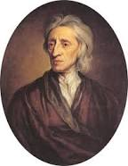
Rights
Established by society and given the highest priority.
Considered to be ethically valid since a large population endorses them.
John Locke (1632 – 1704) English philosopher and physician, was one of the primary supporters of this system.
Focused on three major topics:
Epistemology- theory of knowledge
Political philosophy
Religious toleration.
Notes:
Topics focused by john locke
how we should educate our children,
who should rule over us,
and what we should do about people who have different religious ideas to us.

Slide 41
Rights
When people talk about rights, they are often speaking about two different kinds of rights.
In philosophy books these are usually called
Negative rights (liberties or natural rights)
The right to act without interference
Positive rights (claim-rights)
Impose an obligation on some people to provide certain things for others.

Slide 42
Negative Rights vs Positive
The right to act without interference.
Called “natural rights” because in the opinion of some philosophers we can derive them from the nature of humanity
John Lock, argued that we each have an exclusive right to ourselves, our labor, and to what we produce with our labor. He saw protection of private property as a moral rule.
A positive right is an obligation by others to provide benefits to the rights holder.
A right is a causal effect of a mistake, so if you have a right to something, it implies that eliminating that right or not providing some benefit is wrong or unlawful for others.
Notes:
https://examples.yourdictionary.com/examples-of-rights-based-ethics.html

Slide 43
Example:
Positive Rights
Negative Rights
Positive right to a job could mean that someone must hire you
Positive right to life may mean that others have to pay for your food or medical care
Positive right to freedom of speech may mean that we require to broadcast, my, your, everyone’s views
Positive right to freedom of information may mean no confidentially allowed
Positive right to access the internet could result in others having to pay for your internet access.
Right to life (no one should kill anyone)
Right to be free from assault
Right to use your property
Right to use labor, skills and mind to create goods and services and to trade with people in voluntary exchanges.
Freedom of speech and religion
Right to privacy
Right to access the internet seems obvious in many countries.
However authoritarian regimes restrict it. Which?

Slide 44
Conflict Between Negative and Positive Rights
Some think negative rights (liberties) are almost meaningless/ worthless :
Society must devise social and legal mechanisms that satisfy everyone’s positive (claim rights)
Even if this means diminishing the liberties of some
Others believe there can be no, or very few, positive (claim) rights for some people without violating the liberties of others
They see the protection of liberties, or negative rights as essential
How about privacy as a negative right (liberty) and freedom of information as a positive (claim) right? A possible conflict?

Slide 45
Ethics
Golden rules
Treat others as you would want them to treat you.
Confucius and the Bible
Contributing to society
Doing one’s work honestly, responsibly, ethically, creatively, and well is virtuous.
Social contracts and a theory of political justice
People willingly submit to a common law in order to live in a civil society.
The foundations of this are in the writings of Socrates and Plato
Notes:
Thomas Hobbes developed ideas of social contract theory in his book Leviathan (1651).
Philosopher John Rawls took social contract theory further, developing provisions of the “contract” based on his view of justice as fairness.

Slide 46
Ethics
According to 17th century British philosopher Thomas Hobbes, (social contract theory book Leviathan (1651)).
“Man is rational and will seek a better situation even at the cost of giving up some independence in favor of common law and accepting some authority to enforce this “social contract”.
Which means, right acts are those that do not violate the rational agreements made that makes lives better.
Philosopher John Rawls took social contract theory further, developing provisions of the “contract” based on his view of justice as fairness.

Slide 47
Ethics
No simple answers
Human behavior and real human situations are complex. There are often trade-offs to consider.
Ethical theories help to identify important principles or guidelines.
Ethical theories do not provide clear, incontrovertibly correct positions on most issues. We can use the approaches we described to support opposite sides of many an issue.
Do organizations have ethics?
Ultimately, it is individuals who are making decisions and taking actions. We can hold both the individuals and the organization responsible for their acts.
Notes:
Ethical theories do not provide clear, incontrovertibly correct positions on most issues. We can use the approaches we described to support opposite sides of many an issue.
Some philosophers argue that it is meaningless to speak of a business or organization as having ethics. Individual people make all decisions and take all actions. Others argue that an organization that acts with intention and a formal decision structure is a moral entity. However, viewing an organization as a moral entity does not diminish the responsibility of the individual people.

Slide 48
Personal preference and Ethics
We might find something distasteful but is it ethically wrong?
Some people may not consider a job opportunity in. For example, the arms industry because they do not like the products the company produces, e.g. nuclear bombs
Are they doing this on ethical grounds or is it a personal preference?
Two people with opposing political or social views may both claim they are morally and/or ethically correct – i.e. claim the “moral high ground”

Slide 49
Law vs Ethics
Ethics are rules of conduct. Laws are rules developed by governments in order to provide balance in society and protection to its citizens.
Ethics comes from people’s awareness of what is right and wrong. Laws are enforced by governments to their people.
Ethics does not carry any punishment to anyone who violates it. The law will punish anyone who happens to violate it.
Ethics comes from within a person’s moral values. Laws are made with ethics as a guiding principle.

Slide 50
Law and Ethics: connection?
One cannot be Ethical and follow the law all the time. History allowed the slave trade.
It takes time to recognize new problems associated with the new technology, consider possible solutions, think and debate about the consequences of various proposals and so on
Ethics fills the gap between the time when new technology creates new problems and the time when legislatures pass reasonable laws
A good law will set minimal standards that can apply to all situations, leaving a large range of voluntary choices.
Notes:
Being ethical makes you look like you are against someone or something. What do you do?

Slide 51


Any questions?

